Slide 1
Local Storage
Prepared by Amira Nasser

Slide 2
Agenda
01
02
03
What’s the database
Hive package
Let’s code
04
Now it’s your turn to…..

Slide 3
01
What’s The database

Slide 4
Database
An organized collection of data stored in a computer system and usually controlled by a database management system (DBMS).

Slide 5
Database Management System
A software system to facilitate the creation and maintenance of a computerized database.

Slide 6
Relational Database
Type of database that focuses on the relation between stored data elements. It allows users to establish links between different sets of data within the database and use these links to manage and reference related data.
use SQL (Structured Query Language) to perform queries and maintain data.

Slide 7
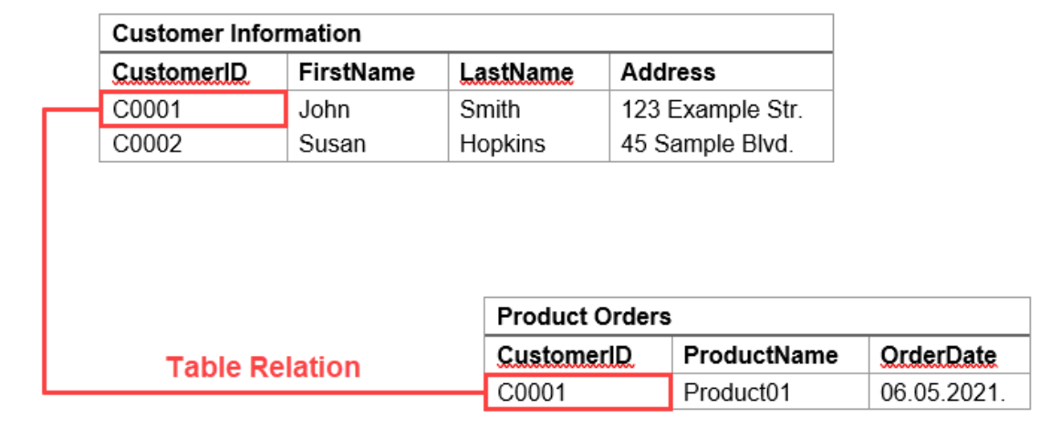
Relational Database

Slide 8
Non-relational Database (NoSQL Database)
Type of database that models and stores data differently from relational databases. Instead of tables, non-relational databases model relationships between data in an alternative way (ex: key-value stores).

Slide 9
02
Hive Package

Slide 10
Hive Package
Helps to store user data locally.
Use key-value database solution.
Non relational DB (NoSQL)
Notes:
A plugin is a more specialized type of package that includes both Dart code and native code (such as Kotlin for Android or Swift for iOS).
A package in Flutter contains only Dart code. It serves as a modular unit of reusable functionality.

Slide 11
03
Let’s Code
Notes:
Dev dependencies are only required during development.
Dependencies:
These are packages that are included in your app during compilation.
They are essential for both development and production of your app.
To run build runner dependency
flutter packages pub run build_runner build

Slide 12
04
Now it’s your turn to…..

Slide 13
Your Turn
Home Screen:
app bar features an Icon button, which navigates the user to the Add Form Screen.
Within the Add Form Screen, users encounter two TextFormField fields: one designated for titles and the other for descriptions.
The body of the Home Screen is populated with a list of Containers, each comprising a title and a description.

